Slide 1

Binary Search Tree Basics
Data Structures
Design and Analysis of Algorithms I

Slide 2
Balanced Search Trees: Supported Operations
Notes:
Container for objects that have keys (employer records, network edges, events, etc.)
Search/min/max/prec/succ/select/rank

Slide 3
Binary Search Tree Structure

Slide 4
The Height of a BST

Slide 5
Searching and Inserting

Slide 6


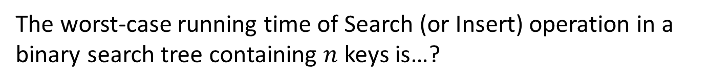


The worst-case running time of Search (or Insert) operation in a binary search tree containing $n$ keys is…?
$$θ(1)$$
$$θ(\log_{2}{n})$$
$$θ(height)$$
$$θ(n)$$

Slide 7
Min, Max, Pred, And Succ

Slide 8

The worst-case running time of the Max operation in a binary search tree containing $n$ keys is…?
$$θ(1)$$
$$θ(\log_{2}{n})$$
$$θ(height)$$
$$θ(n)$$

Slide 9
In-Order Traversal

Slide 10
Deletion

Slide 11
Deletion (con’d)

Slide 12
Select and Rank

Slide 13
Select and Rank (con’d)

